Slide 1
CluedIn AI training: AI agents
Keeping your data clean, enriched, and flowing 24/7 with traceability, auditability, and user-controlled oversight at every step

Slide 2
Explore the concept of AI agents in CluedIn
Learn about typical tasks AI agents can perform
Training agenda
Walk through the process of working with AI agents
Discover the recommended best practices

Slide 3
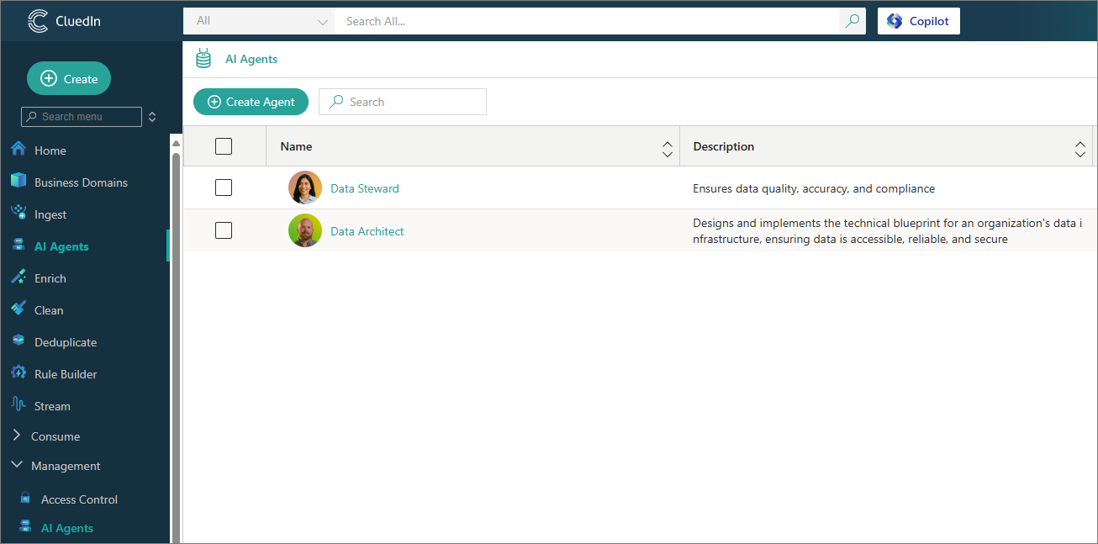

AI agents in CluedIn
The AI Agents module in CluedIn is a smart automation component that uses artificial intelligence to assist with key data management tasks.
This enables you to focus on strategic decisions rather than repetitive tasks, while ensuring higher data consistency and reliability.

Slide 4






Agentic Data Management with
Hi, how can I help you?
AI Agents and Copilot
Mapping, fixing, and governing data is now
as simple as asking — 24/7, in real time

Slide 5
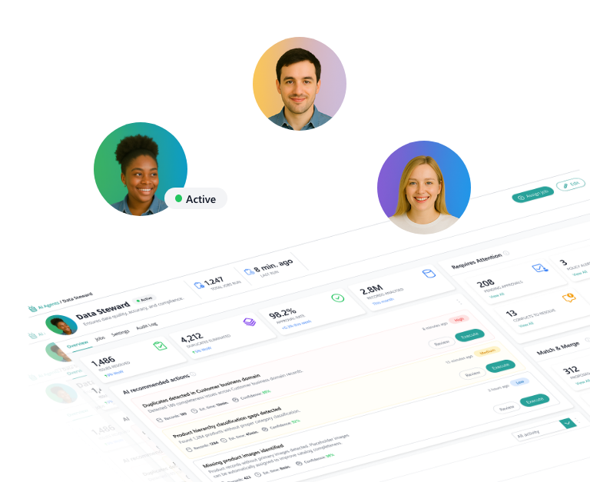
Autonomy with control
CluedIn AI Agents automate deduplicating, tagging, fixing, and enriching – all on your terms, with full control and auditability
Error detection
Automated fixes
Identify duplicates and data quality issues
Suggest and apply corrections at scale
Continuous monitoring
Customizability
Keep data quality stable over time
Configure agents for business-specific needs

Slide 6

Built to flex with your stack
CluedIn AI Agents support all major LLMs – including OpenAI. Use your preferred model. We deliver the outcomes
Phi-4

Slide 7




AI agent skills
AI agents can perform a variety of tasks (also called skills)
Look for duplicate records
Fix data quality issues
Suggest data quality rules

Slide 8
AI agent skills
AI agents can perform a variety of tasks (also called skills)
Look for duplicate records
Fix data quality issues
Suggest data quality rules
Scan a data source for potential duplicate records and group them into a deduplication project for further review

Slide 9
AI agent skills
AI agents can perform a variety of tasks (also called skills)
Look for duplicate records
Fix data quality issues
Suggest data quality rules
Analyze a data source and provide suggestions on how to improve data accuracy and consistency

Slide 10
AI agent skills
AI agents can perform a variety of tasks (also called skills)
Look for duplicate records
Fix data quality issues
Suggest data quality rules
Evaluate a data source and recommend potential data quality rules that can be applied to maintain standards over time

Slide 11
AI agent skills
AI agents can perform a variety of tasks (also called skills)
Look for duplicate records
Fix data quality issues
Suggest data quality rules
And more to come…

Slide 12
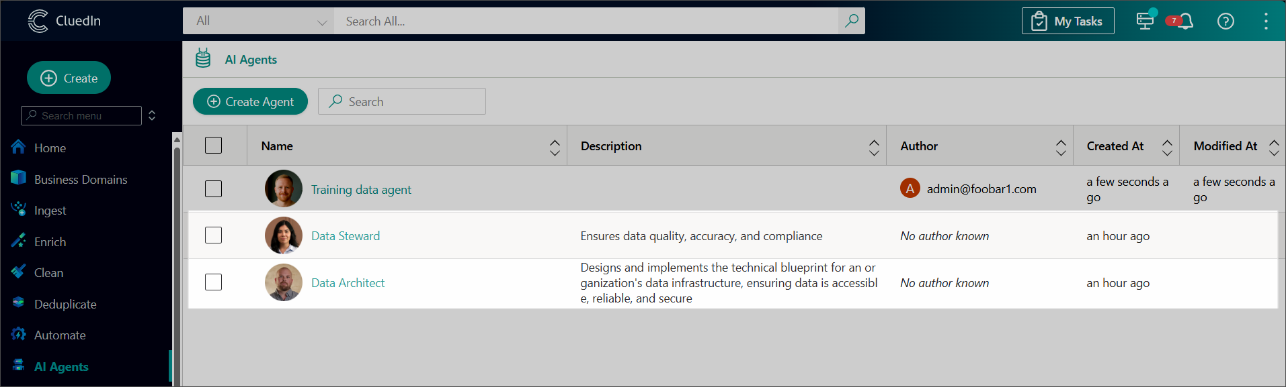
Built-in AI agents
CluedIn provides two built-in agents:
Data Steward – Ensures data quality, accuracy, and compliance. By default, this agent has the following tasks: fix data quality issues, look for duplicate records.
Data Architect – Designs and implements the technical blueprint for your organization's data infrastructure. It ensures that data is accessible, reliable, and secure. By default, this agent has the following task: suggest data quality rules.

Slide 13
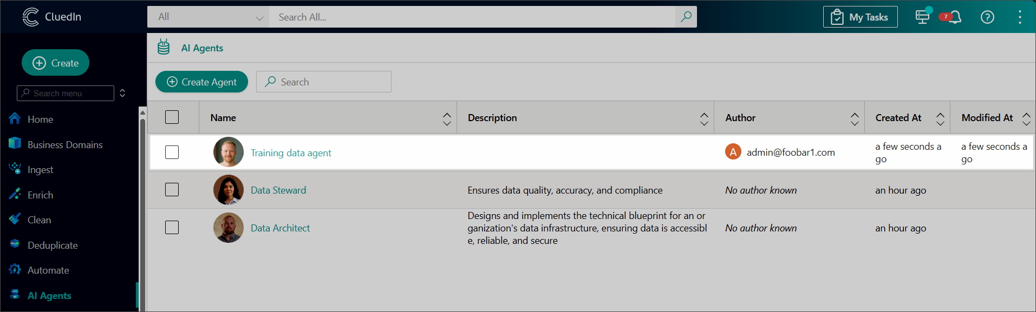
Your data, your agents
The real strength lies in customization—you can easily create your own agents to keep up with your evolving data challenges.

Slide 14
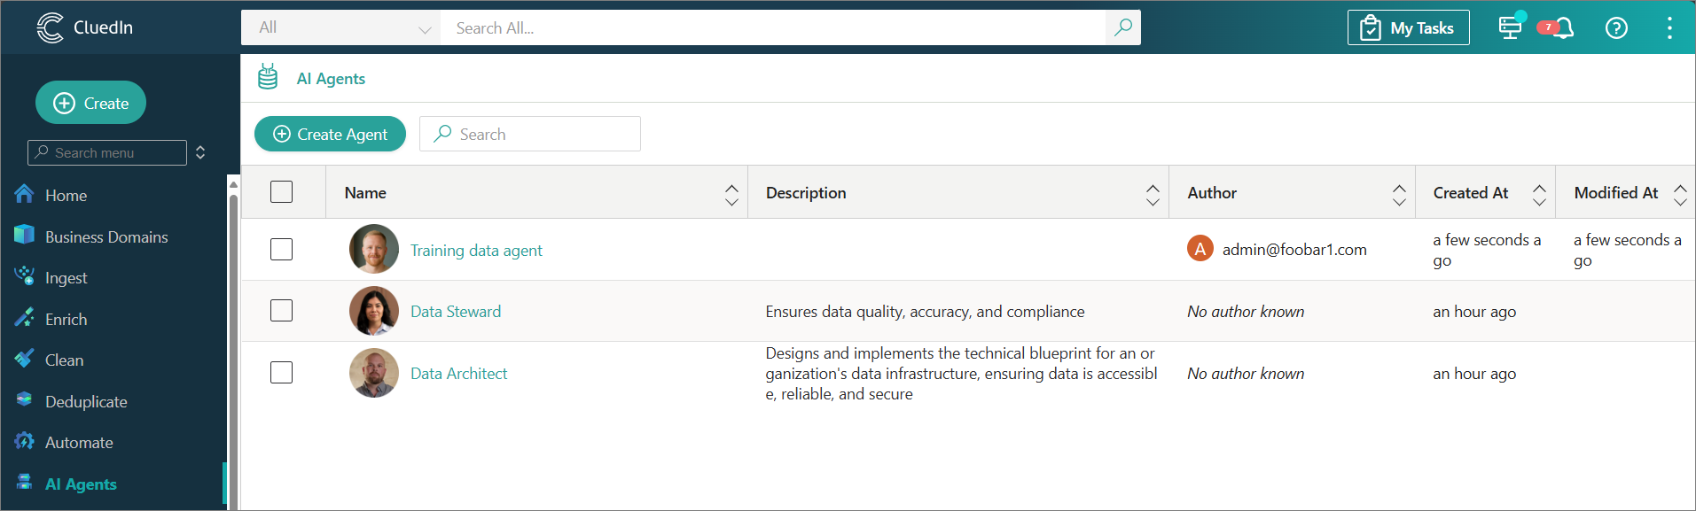
Working with AI agents
Select an AI agent to use
Use a built-in agent
Create a custom AI agent

Slide 15
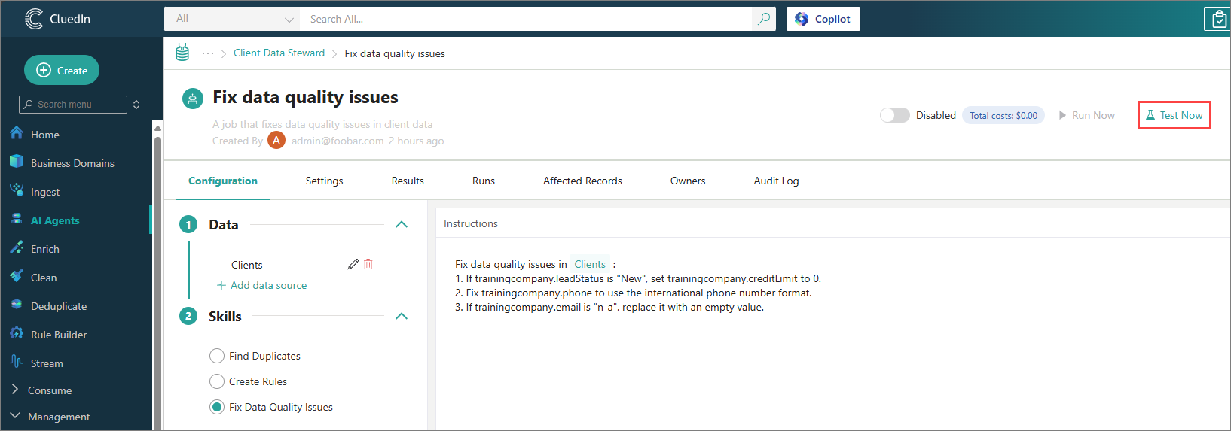
Working with AI agents
Select an AI agent to use
Configure an AI agent job
Create a job (a task to perform over a subset of data)
Select a data source
Enter a prompt
Test the job
Run the job

Slide 16
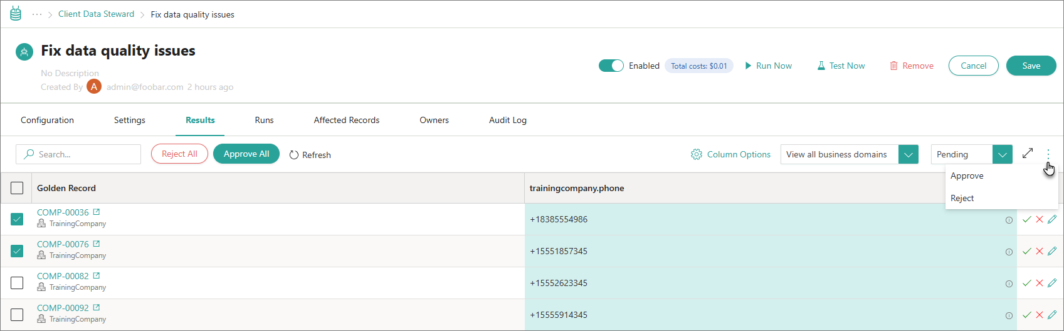
Working with AI agents
Select an AI agent to use
Configure an AI agent job
Review AI agent suggestions
Review is not required for the “Find duplicates” skill
Administrator can enable the automatic approval of AI agent suggestions

Slide 17


01
Start with smaller test runs to validate AI agent suggestions
02
Review high-impact changes before applying at scale
03
Combine AI agents with Copilot and AI Enricher for even better results
Best practices for using AI agents
04
Experiment

Slide 18
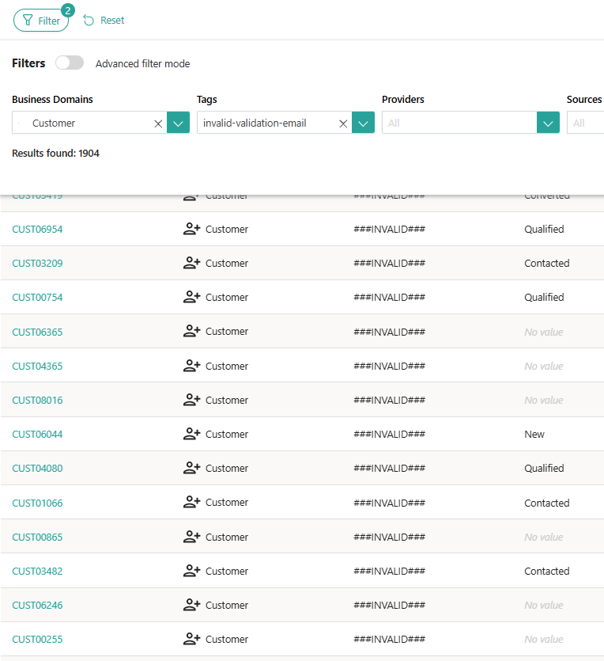


Learn more about AI agents in our documentation portal.
Next session: Demo of using AI agents in practice.
What’s next?

